Slide 1
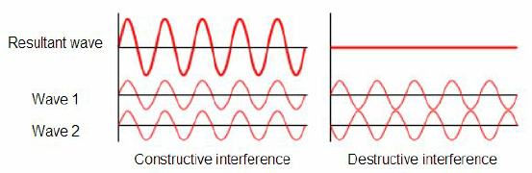
Interference of light
Why we study interference of light?
Important terms for understanding interference of light
1. Superposition principle
Prof. Dr. H. M. A. R. Maruf, Department of Physics, CUET

Slide 2
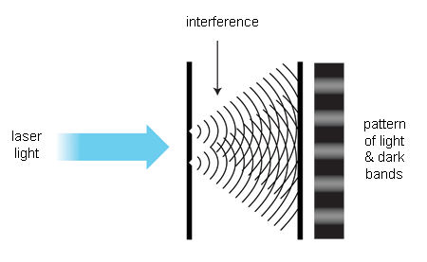
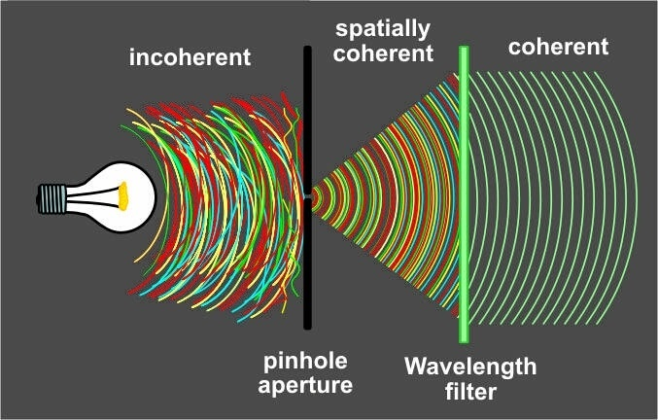
Interference of light
2. Coherent sources
Prof. Dr. H. M. A. R. Maruf, Department of Physics, CUET

Slide 3
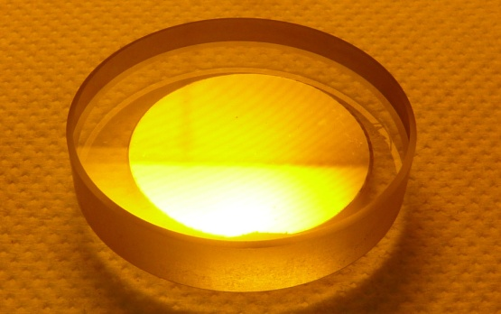
Interference of light
3. Monochromatic light
Sodium Light
Prof. Dr. H. M. A. R. Maruf, Department of Physics, CUET

Slide 4
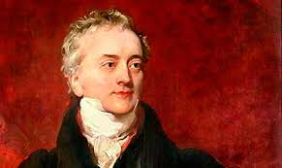
Thomas Young in 1801
Interference of light
If two beams of light cross each other at a certain point, in the region of cross over where both the beams are acting simultaneously, according to superposition principle a modification in their intensity is expected. The resultant intensity will be either great or less than that which would be given by one beam alone. This modification of intensity due to superposition of two or more beams of light is known as interference of light.
Prof. Dr. H. M. A. R. Maruf, Department of Physics, CUET

Slide 5
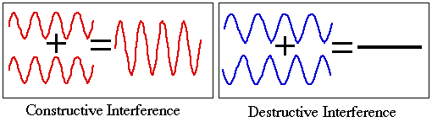
Types of interference of light
Constructive interference
Destructive interference
Prof. Dr. H. M. A. R. Maruf, Department of Physics, CUET

Slide 6
Conditions of the interference
The two beams of light which interfere must be coherent.
The two interfering waves must have the same amplitude.
The original source must be monochromatic.
The fringe-width should reasonably be as large as possible and the separation between the two sources should be as small possible while the distance of the screen form the sources should be as large as possible.
The two interfering waves must be propagated in almost the same direction.
Prof. Dr. H. M. A. R. Maruf, Department of Physics, CUET

Slide 7
Uses of interference
To determine the refractive index of liquids and gases.
To determine the width of a liquid and glass plate.
To determine the smoothness of a liquid and glass plate.
To determine the wavelength of light.
5.To measure the thickness of a very thin film.
Prof. Dr. H. M. A. R. Maruf, Department of Physics, CUET

Slide 8
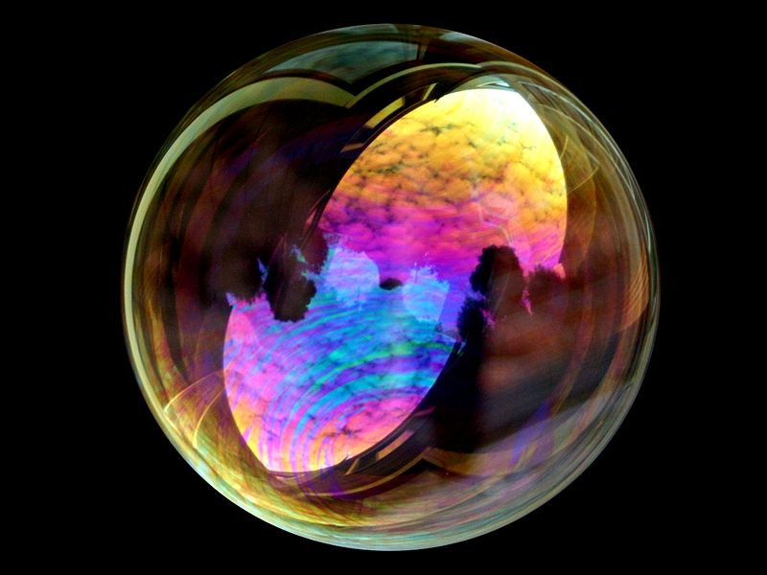
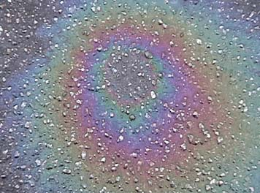
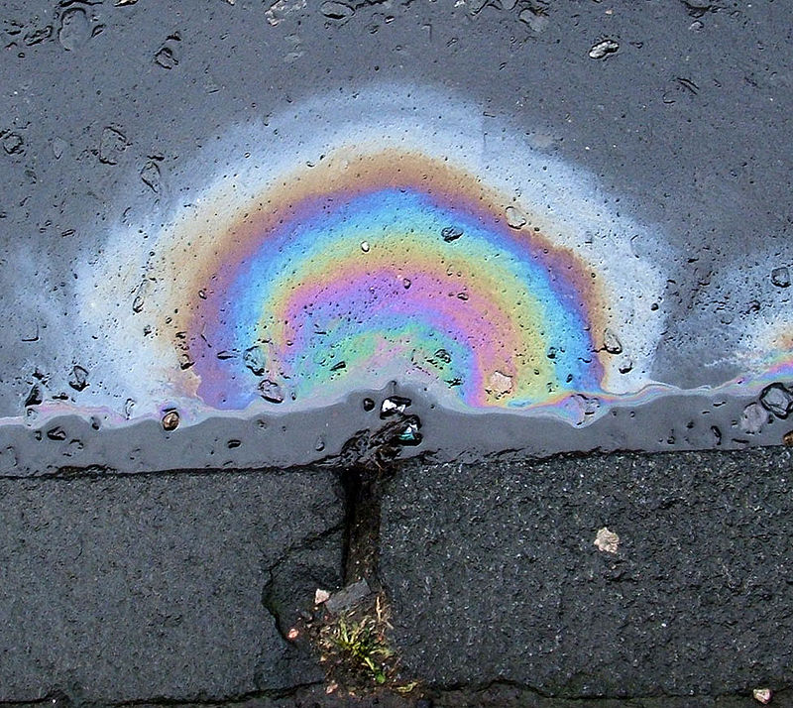
Examples of interference of light
Soup buble
Oil film on water
Prof. Dr. H. M. A. R. Maruf, Department of Physics, CUET

Slide 9
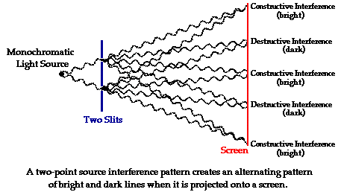
Interference of light waves: analytical treatment
Prof. Dr. H. M. A. R. Maruf, Department of Physics, CUET

